Slide 1
CS 528 - DEMO 5
Stop Wasting the Cloud
Mentors:
Dan Macpherson
Patrick Dillion
Team Members:
Anshu Goel
Jhukhirtha Marhi Arokiasamy
Sahil Gupta
Sidharth Bakshi
Vedant Mahabaleshwarkar
Notes:
aks

Slide 2
Recap
Vision: Utilize slack resource in each node to run BOINC jobs
Sprint 1: We had already containerized BOINC based CentOS image in our local machines.
Sprint 2: Deploy the image on MOC as Daemonset and research how it scales and interacts with other pods
Sprint 3: Set up Cgroup limit for BOINC and perform initial benchmarking tests mocking BOINC as primary application
Sprint 4: Developed a high-utilizing primary application to perform benchmarking tests and Tune boinc to make it less aggressive and not affect the primary application
Notes:
Optimally use the slack resources on Openshift cluster to run BOINC jobs without affecting the primary applications.
Then we built BOINC based CentOS image in our local machines
Then we deployed the BOINC based CentOS image on MOC’s Openshift clusters as a Daemonset
Then we observed that the other primary applications were getting affected, so we setup c-group limits for BOINC. And we performed initial benchmarking tests where the primary application was also BOINC but gave us which were inconclusive. So we developed a multithreaded C program to act as a primary application along with BOINC loads and observed that BOINC severely affected the performance of the primary application.
So in this Sprint , we explored different solutions to scale down BOINC so that primary ap
Optimally use the slack resources on Openshift cluster to run BOINC jobs without affecting the primary applications.
Then we built BOINC based CentOS image in our local machines
Then we deployed the BOINC based CentOS image on MOC’s Openshift clusters as a Daemonset
Then we observed that the other primary applications were getting affected, so we setup c-goup limits for BOINC. And we performed initial benchmarking tests where the primary application was also BOINC but gave us which were inconclusive. So we developed a multithreaded C program to act as a primary application.

Slide 3
Configuration: BOINC non-aggressive
Set a buffer over the burstable limit for how many cpus BOINC can consume
Configuration:
Node 1: Primary application with workload of 70%
Node 2: Same as node 1 and running BOINC job with burst-able limit 60% while passing min(.8, log((burstable limit percentage/10) + 1.4)) * total_cpus_of_machines in BOINC config file.

Slide 4
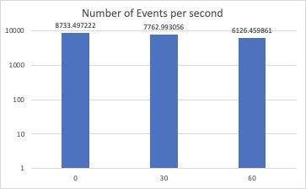
Result
X axis: Burstable Limit of BOINC
Y axis: Number of events in logarithmic scale

Slide 5
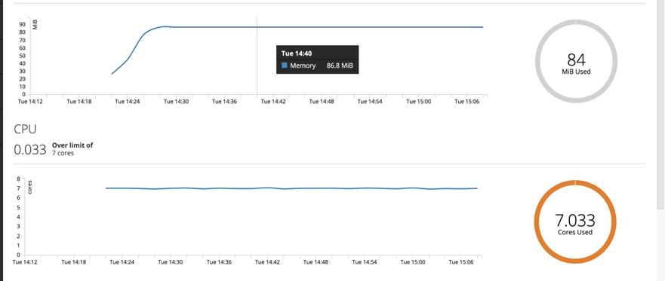
Node 1:CPU Utilization for Primary application

Slide 6
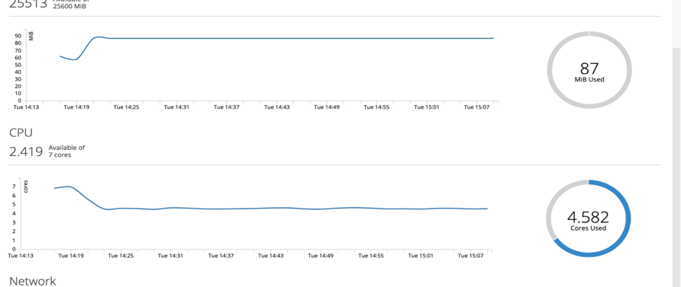
Node 2: CPU Utilization for Primary application

Slide 7
Issues with BOINC scaling down
In order to avoid CPU contention, the BOINC app needs to consume less resources when the primary application starts consuming more
BOINC has an option to suspend itself if non-BOINC load exceeds X%
The non-BOINC load is calculated by looking at cpu utilization of processes and summing them up
So BOINC can not look at the process outside its container as it would be outside its namespace
Hence, BOINC did not suspend itself when:
Primary (non-BOINC) load = 70%
BOINC set to suspend if non-BOINC load > 10%

Slide 8
Issues with BOINC scaling down
However, it is possible to view the CPU utilization at a hardware from any container
Psutil, a cross platform Python library, allows you to monitor resource utilization at a hardware level
It means it is possible to change BOINC’s code to get resource utilization at a hardware (node) level

Slide 9
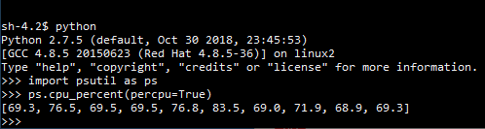
Issues with BOINC scaling down
Running psutil inside the BOINC container

Slide 10
Solutions to the scaling down problem
Possible solutions to scale down BOINC depending on the actual resource consumption:
Have a wrapper around BOINC within the container: Processes managing other processes is not a good practice
Have an external controller outside the pod (like a VPA): This would kill, not suspend, the BOINC container and increase the complexity of deployment
Make changes to BOINC’s source code: What we are doing

Slide 11
Current BOINC calculations
Currently, this is how BOINC calculates resource utilization for boinc jobs
Get the process map from the system
Start from the main boinc process, and move to all child processes, and add up utilization for these processes.
Result is the total utilization of boinc processes.

Slide 12
Current BOINC calculations
Currently this is how BOINC calculates resource utilization for non-boinc jobs
Visit the process map again
For all the process with flag : is_boinc_app = False, add up utilization
Result is the total utilization of non-boinc jobs
These calculations are flawed in a container environment because the process map only contains processes within the container. Thus, BOINC always calculates the non-boinc utilization to be zero, and never suspends.

Slide 13
Proposed changes
There are two things visible from inside a container.
Total utilization of machine
Total utilization of current container
We will change the formula for non-boinc utilization as follows Non-boinc utilization = Total utilization - total boinc utilization

Slide 14
Deployment automation
Since we were constantly deploying various configurations, we thought it would be more convenient to automate these deployments.
The algorithm for the script is as follows : Primary_list = [] //contains the yaml file names of all the primary deployments Secondary_list = [] //contains the yaml file names of all the primary deployments // Primary[i] + Secondary [i] together comprises of a deployment. For i in range(length(primary)): 1. If primary deployment exists, deploy primary[i] 2. If secondary deployment exists, deploy secondary[i] 3. Sleep(x) //x is the time for which the application should be deployed on the cluster 4. Collect logs for primary[i] 5. Delete primary[i], secondary[i]

Slide 15
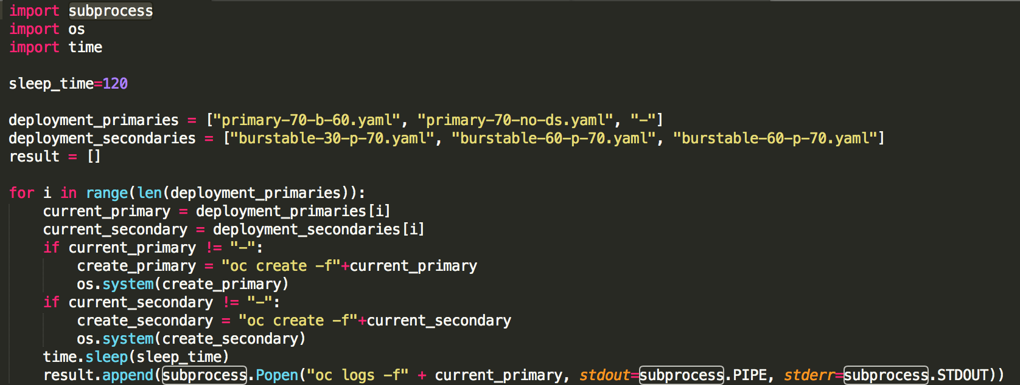
Deployment Script

Slide 16
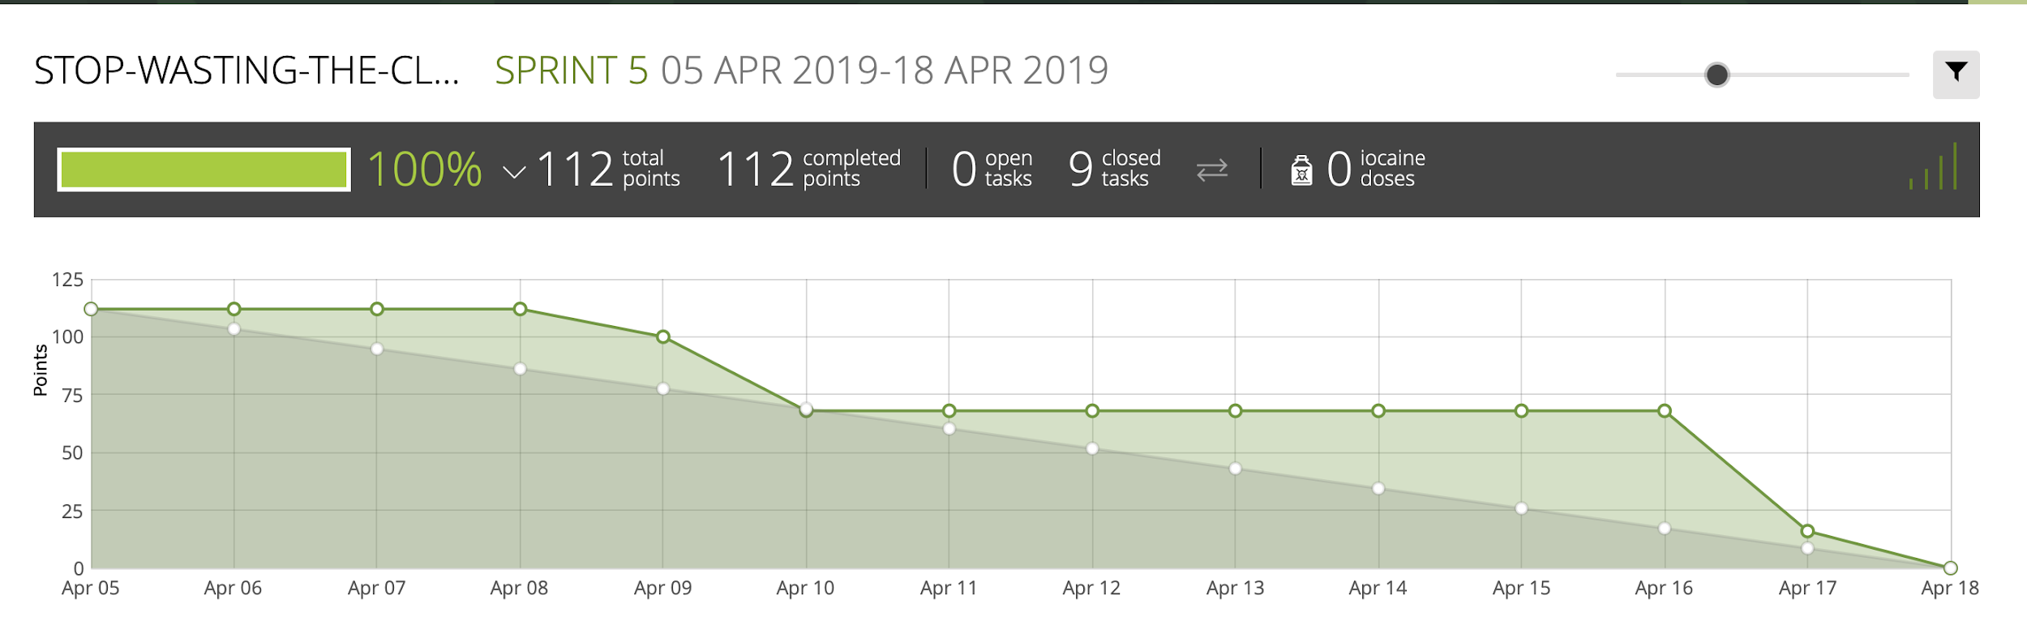
Burndown Chart

Slide 17
QUESTIONS?

